Slide 1
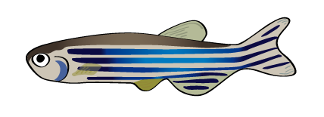
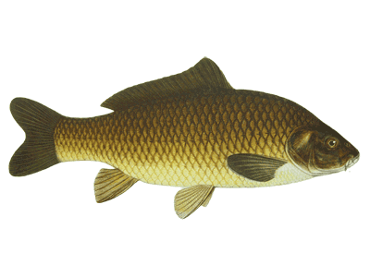
Bioinformatics Bsc Project 1
Proteomics of model systems
Understand protein distribution in healthy orgamism
Zebrafish proteome
mass-spec data from LUMC, available
Common Carp proteome
mass-spec data from LUMC, available
large, related to zebrafish
production fish

Slide 2
Bioinformatics Bsc Project 2
Proteomics of model systems
Proteomes are analysed in subsystems
Skin, Brain, Muscle, Intestine ...
Intestine: mass spec give mixed result
proteome of the sample, i.e. zebrafish, carp
proteome of the microbiome of zebrafish/carp
Question: what is intestine and what is microbiome.

Slide 3
Bioinformatics Bsc Project 2
Proteomics of model systems
Goal: Derive Microbome proteome through subtraction of proteome data and comparison to microbial datasets (know intestine flora)
Result: knowledge on microbial compostions of intestine.
Approach: Use processing pipelines, Search Genomes, Combine data sources, Include new data (analysis)
Supervision
Prof Dr HP Spaink (IBL),
Dr MN Palmblad (LUMC),
Prof Dr Ir FJ Verbeek (LIACS)
Start
December 2018 (2 students, 1 zebrafish, 1 carp)
Literature study, Tool study, Analysis, Implementation
Cluster computing

Slide 4
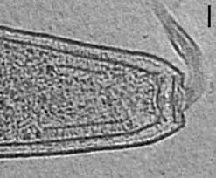
Bioinformatics Bsc Project 3
Data management of Electron Microscopy data
eTomogram represents 3D tilted dataset study used: bacterial chemotaxis (Briegel et al.)
preprocessing of the eMicrographs
Raw data are compressed
Reconstruction to 3D dataset
Many reconstructions, need be organised
Database
Example setup from CalTech (USA, CA) Web-based, interface, Fit into processing pipeline
Evaluate and improve database Include annotation of the images Link to cluster computation (LIACS BioInformatics Cluster)

Slide 5
Bioinformatics Bsc Project 3
Goal: Evaluate and Implement eTomogram Database
Result: Working database for eTomograms and processing pipeline.
Approach: Start from Caltech database, Import data, Built annotation tool, Combine data sources,
Supervision
Prof Dr A Briegel (IBL), Ultrastructural Biology
Dr J Depelteau (IBL), Ultrastructural Biology
Prof Dr Ir FJ Verbeek (LIACS)
Start
December 2018 ( 1,2 students)
Literature study, Code evaluation, implementation
WebInterface, Database Deployment, Cluster computing

Slide 6
Bioinformatics Bsc Project 4
Optimization Distributed Computing of Microscope Data
Goal: Fast analysis and pattern recognition in High-Throughput Microscope data (zebrafish)
Result: Processing pipeline on the LIACS Bioinformatics Cluster
Approach: Optimize existing scripts, sort out optimization.
Supervision
Prof Dr Ir FJ Verbeek (LIACS)
Dr K Rietveld (LIACS)
Start
December 2018 ( 1 student)
Literature study, Code evaluation,
Machine learning

