Slide 1
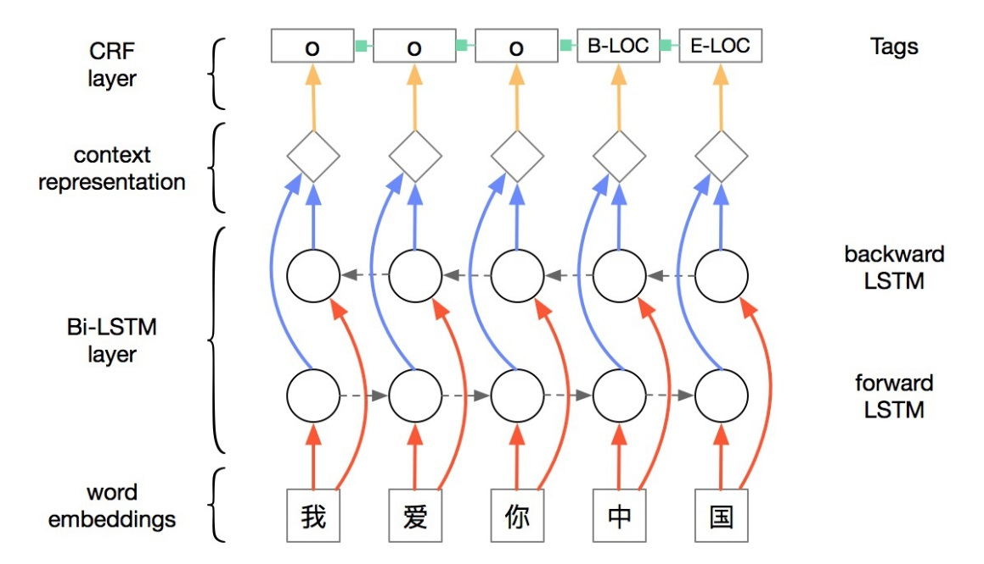
Medical entity extraction from social media
Anne Dirkson
e.g. I took some Ritalin and it gave me bad headaches
BiLSTM + CRF
CRF
vs.
Weighted
features
Words
a.r.dirkson@liacs.leidenuniv.nl
adapted from: http://www.kiwee.me/chinese-ner-based-bi-lstm-and-crf

