Slide 1
Mitra Baratchi
ADA (Automated Design of Algorithms) group, LIACS, Assistant professor

Slide 2
Urban computing
(Spatio-temporal data mining, Mobility data mining)

Slide 3
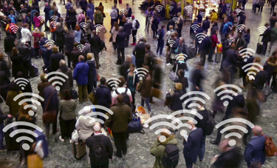
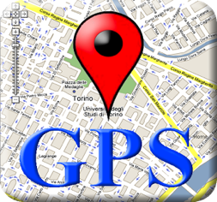
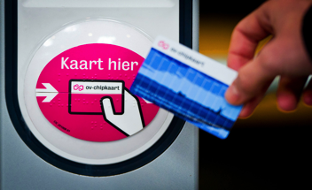
Spatio-temporal datasets

Slide 4
Topic 1: Extracting social interaction patterns between children using proximity sensor data
Skills that you need or develop:
Knowledge of data mining and machine learning algorithms
Programming (e.g. python)

Slide 5
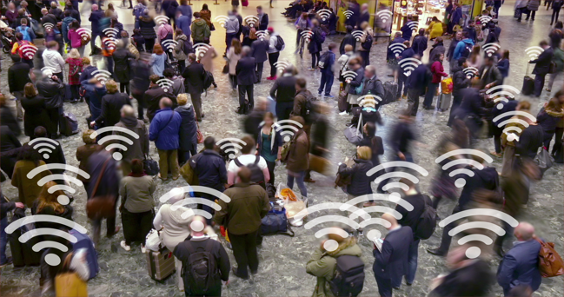
Topic 2: Modeling pedestrian movements using WiFi scanning day
Skills that you need or develop:
Knowledge of data mining and machine learning algorithms
Network analysis
Programming (e.g. python)

Slide 6
M.baratchi@liacs.leidenuniv.nl
www.mitrabaratchi.com
Office no. 116

